Slide 1
Machine Learning Regression

Slide 2
Table of Contents
Introduction
Type of ML Models
Supervised Learning
Linear Regression
Optimization
Decision Tree
Decision Tree Split Methods
Bias-Variance Tradeoffs
Regularization
Data Processing Techniques
Feature Engineering & Feature Selection
Other Algorithms for Regression
Hypothesis Testing

Slide 3
Introduction
Machine Learning is the science of making computers to act without being explicitly programmed.
A computer program is said to learn from Experience E with respect to some class of Task T and Performance measure P if its performance at tasks in T, as measured by P, improves with experience E
Data is the king
System learn from the data without human interventions
Supervised Learning
Task of inferring a function [Y = F(x)] from labelled data
Each record consist of input feature and output value
Example: Regression, Classification
Unsupervised Learning
No Labelled data
Used for finding hidden patterns as well as feature engineering
Example: Clustering
Semi-supervised Learning
Between Supervised and Unsupervised
Incomplete training data (Some of training data missing)
Reinforcement Learning
Machines have to automatically determine the ideal behavior within a specific context in order to maximize its performance
Reward feedback

Slide 4
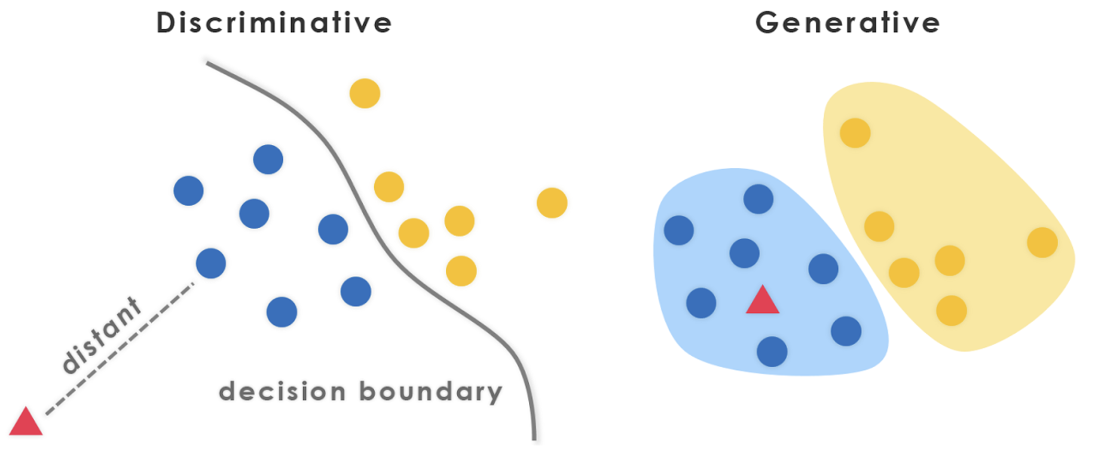
Type of ML Models
Conditional Probability
P(A|B) = [P(B|A)*P(A)]/P(B)
Probability Mass Function
Probability Density Function
Generative and Discriminative Models
Discriminative model models the Decision Boundary between Classes
Generative Model ‌explicitly models the actual Distribution of each class
P(Y/X)
Discriminative Model
Generative Model
Directly learn P(Y|X)
No Assumptions made on P(X|Y)
Eg: Logistic Regression, Neural Networks, SVM etc.
P(Y|X) = P(Y)P(X|Y)
Learn P(Y) and P(X|Y). Joint Probability, Bayes Rule
Assumes all features are conditionally independent
Eg: Bayesian Learning, Naive Bayes Classifier etc.
http://primo.ai/index.php?title=Discriminative_vs._Generative

Slide 5
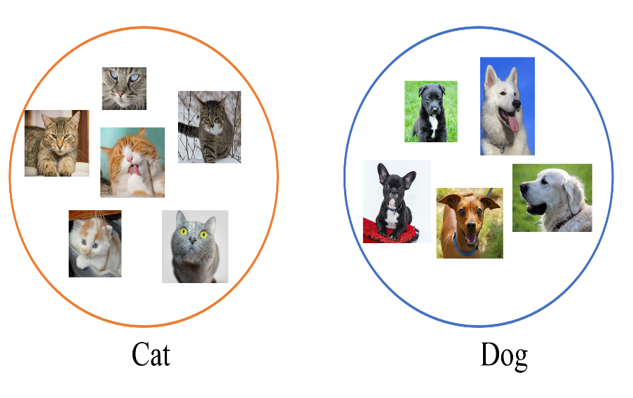
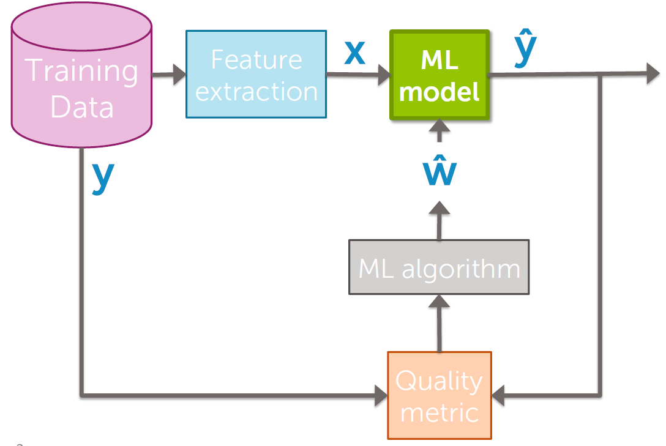
Supervised Learning
Supervised learning is where you have input variables (x) and an output variable (Y) and you use an algorithm to learn the mapping function from the input to the output.
Y = f(x)
The goal is to approximate the mapping function so well that when you have new input data (x) that you can predict the output variables (Y) for that data.
Supervised machine learning algorithms are designed to learn by example.
Regression (Continuous Values): Predict House price.
Classification: Classify whether a mail is spam or not.
ML Pipeline

Slide 6
Model Evaluation
Train Set
Train Set
Test Set
Cross Validation
Trian set to K-fold cross validation
Test Set
Let’s say 5-fold cross validation
Valid
Train
Train
Train
Train
Avoid overfitting
Model selection
Hyperparameter tuning
Data Efficient
Computation cost and Time
Overfitting Vs Underfitting tradeoff
Train
Valid
Train
Train
Train
Train
Train
Valid
Train
Train
Train
Train
Train
Valid
Train
Train
Train
Train
Train
Valid

Slide 7
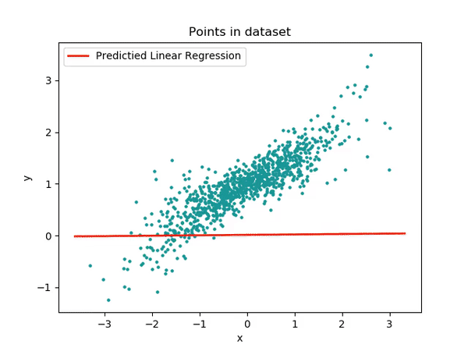
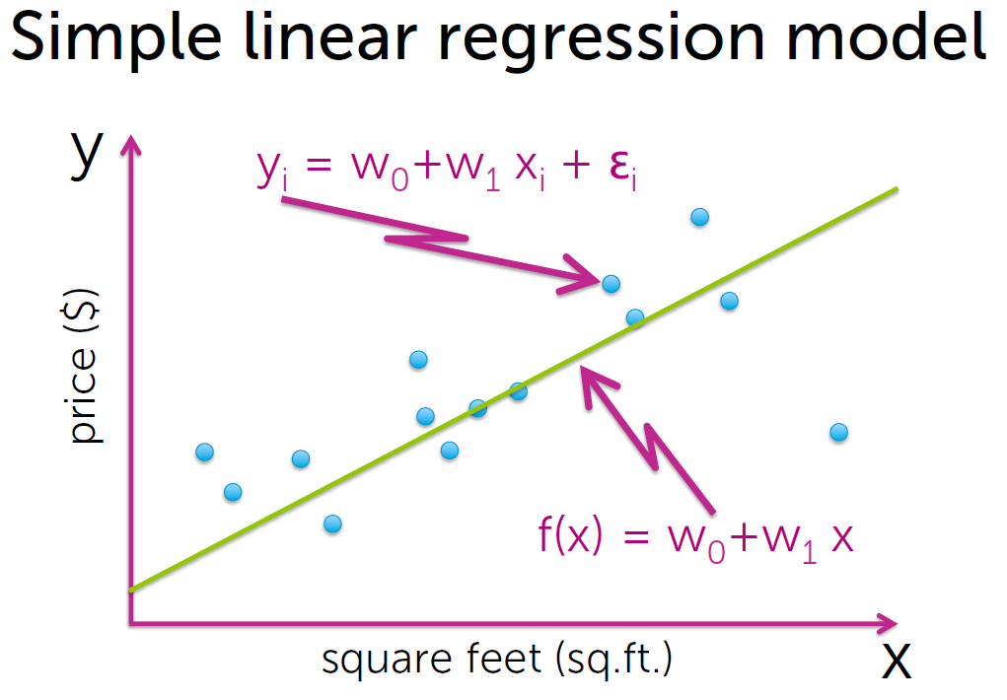
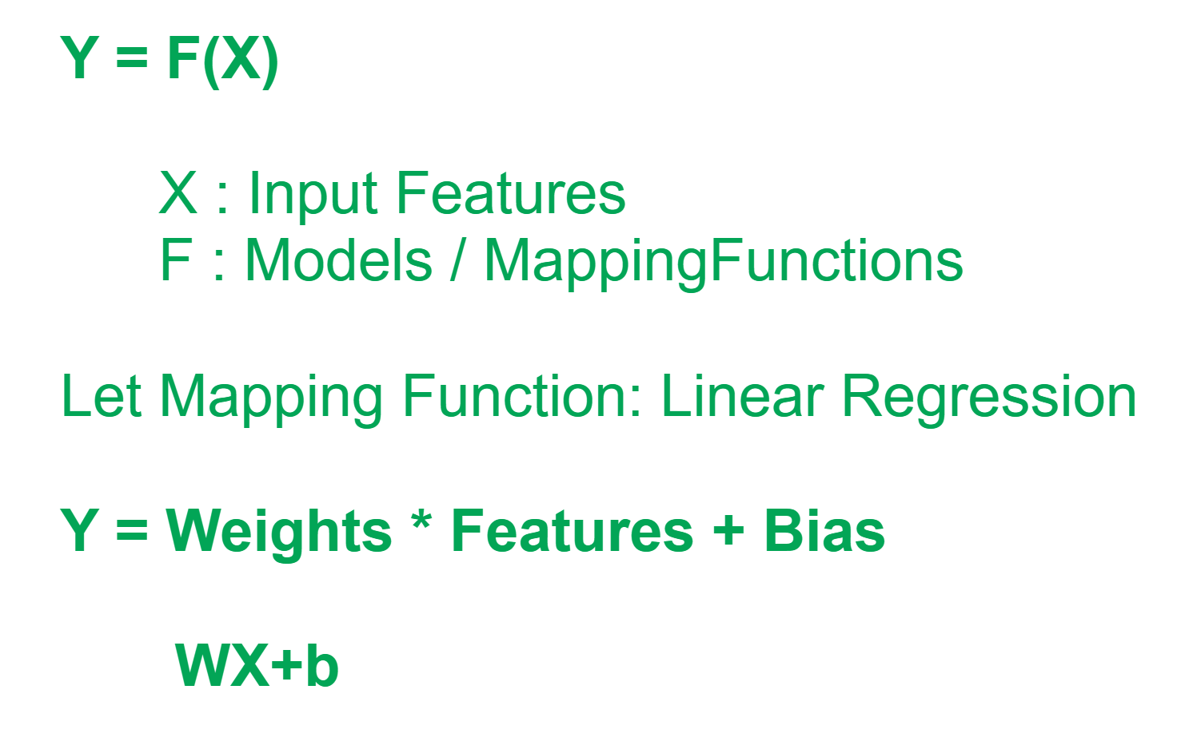
Linear Regression 1/4
Identify relationship between independent variables (x → features/predictors) and dependent variables (Y→ outcome)
Outcome is continuous
Algorithm : Linear Regression, Ridge Regression, Tree Models, SVR, Neural Networks etc.

Slide 8
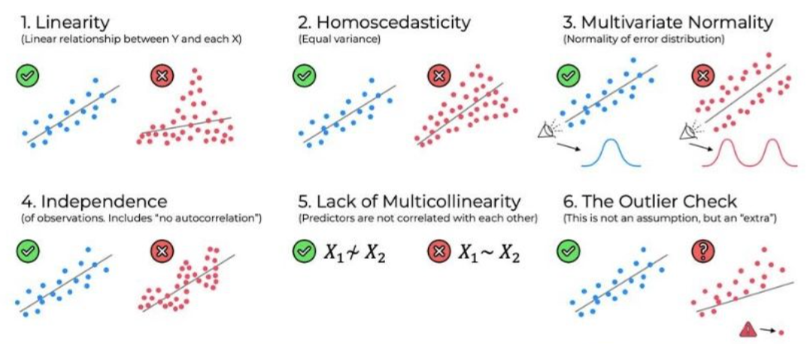
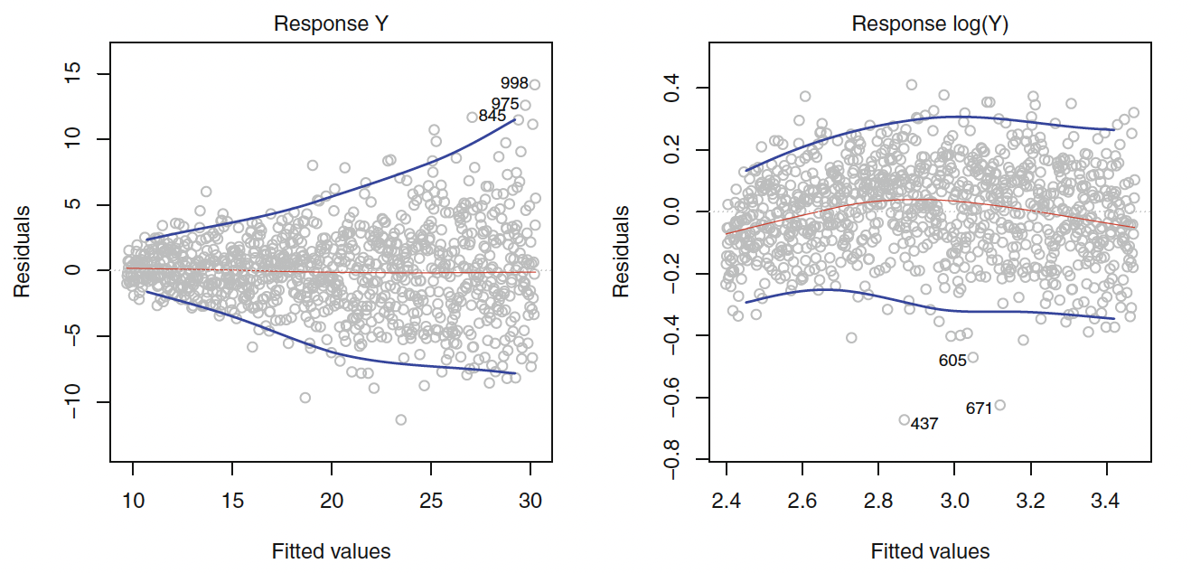
Assumption of Linear Models 2/4
Linearity Check: Residual pot – Residual vs Fitted
Transformation of predictors (log, square etc.)
Correlation of Error Terms: Residual vs time
provide unwanted confidence
underestimate true standard error of coefficients
Error terms have constant variance (Homoscedasticity): Funnel shape in residual plot

Slide 9
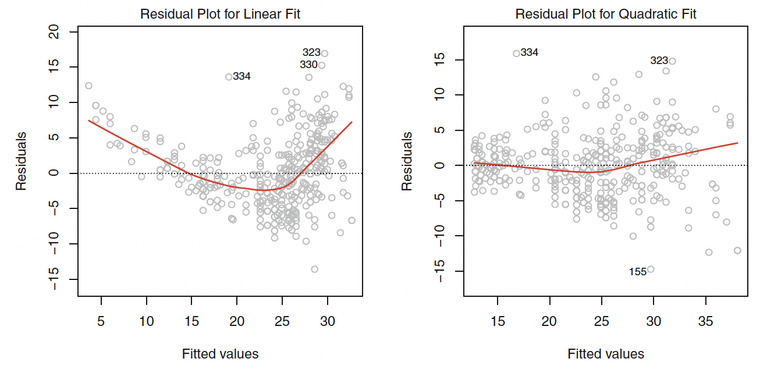
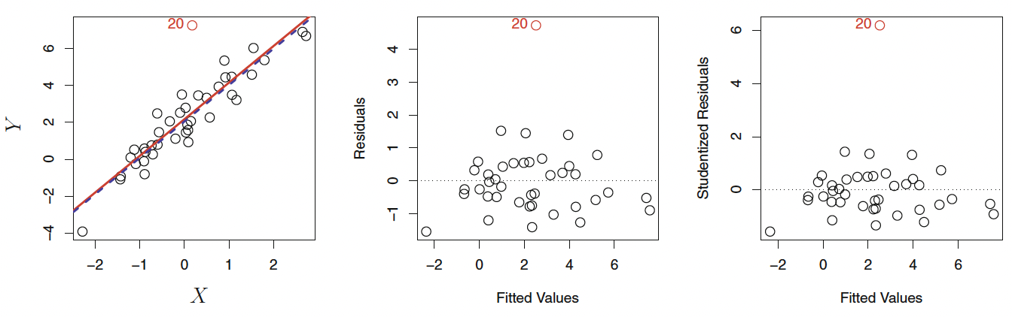
Assumption or potential problems of Linear Models 2/4
Linearity
Constant variance of error terms
Outliers
Multicollinearity
Studentized residuals >3 can be removed
Linearity Check: Residual pot – Residual vs Fitted: Transformation of predictors (log, square etc.)
Variance Inflation Factor (VIF) can be used to identify multicollinearity. VIF = 0 implies no
multicollinearity at all. VIF>5 is problematic
Error terms have constant variance (Homoscedasticity): Funnel shape in residual plot : Transform Y

Slide 10
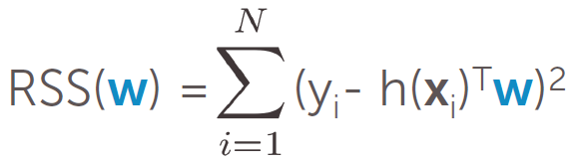
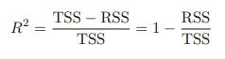
Linear Regression 3/4
How to get the final weights?
Error | Loss | Cost Function
Tries to approximate function which minimizes error
→ Learn best weights for the feature
R Squared Statistic
RSS provides an absolute measure of lack of fit, but measured in the unit of Y.
R squared Statistic gives proportion if variance explained.
Always in the range of 0 to 1 and independent of the scale of Y
The adjusted R-squared is a modified version of R-squared that adjusts for the number of predictors in a regression model.
Adjusted R² = 1 – [(1-R²)*(n-1)/(n-k-1)]
where:
R²: The R² of the model
n: The number of observations
k: The number of predictor variables
TSS measures the total variance in the response Y and can be thought of as the amount of variability inherent in the response before the regression is performed.
RSS measures the amount of variability that is left unexplained after performing the regression
TSS − RSS measures the amount of variability in the response that is explained (or removed) by performing the regression, and R2 measures the proportion of variability in Y that can be explained using X

Slide 11
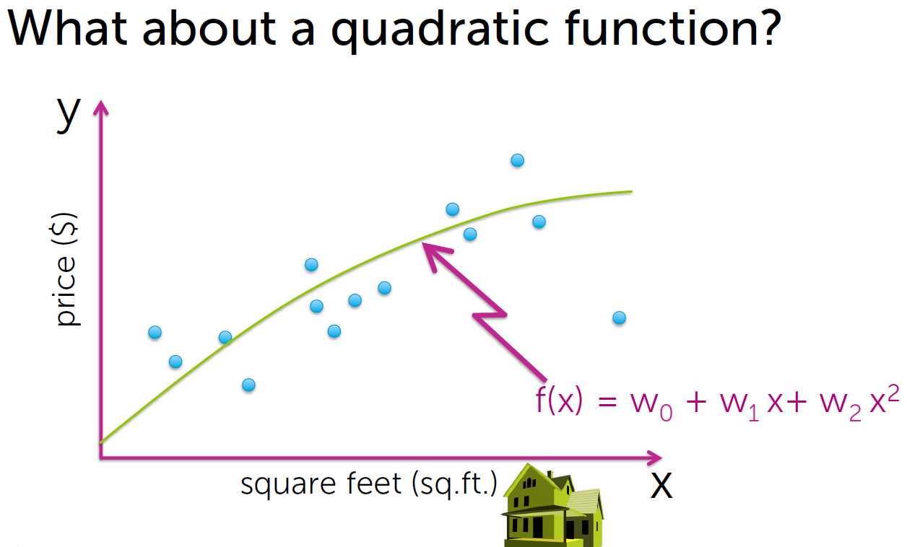
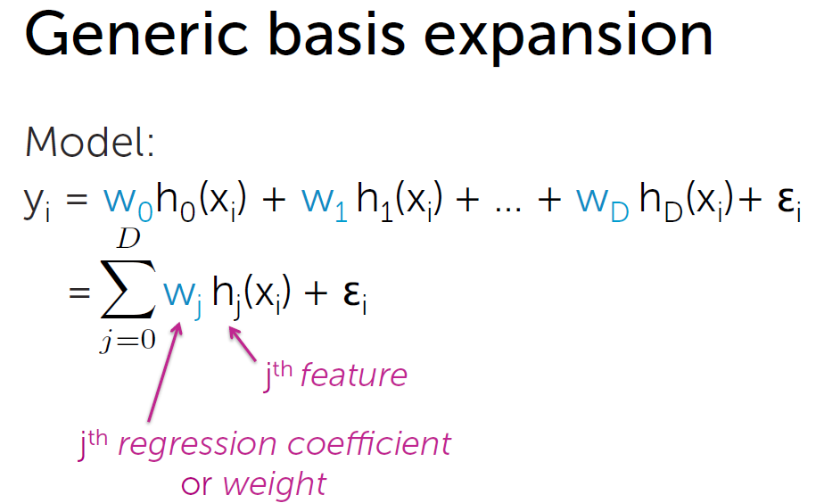
Linear Regression 4/4

Slide 12
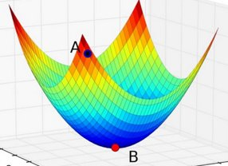
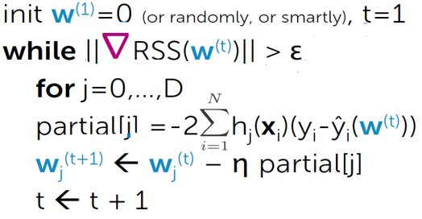
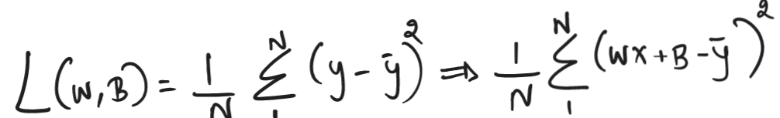
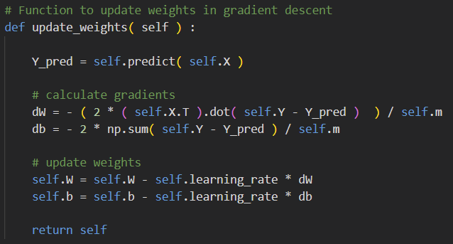
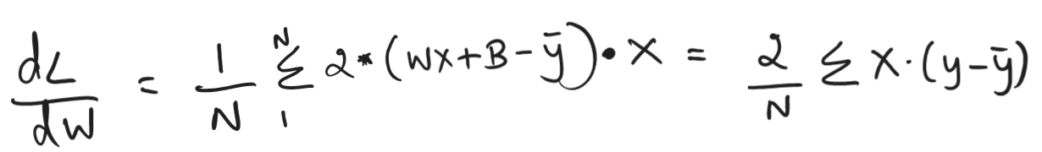
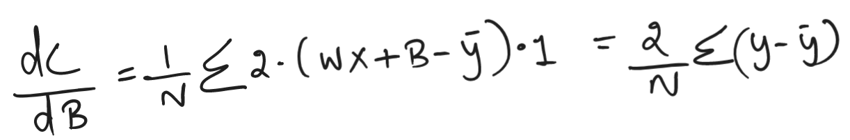
Optimization
Gradient Descent
Batch Gradient Descent
Online Gradient Descent
Calculating Derivative
of Loss Function

Slide 13
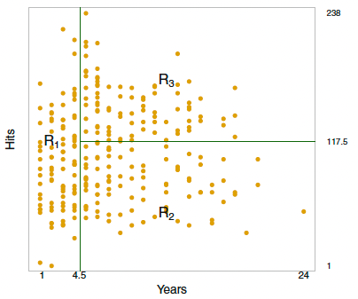
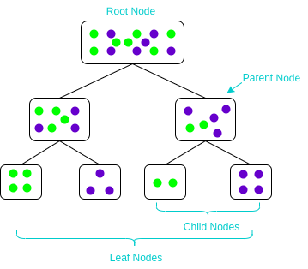
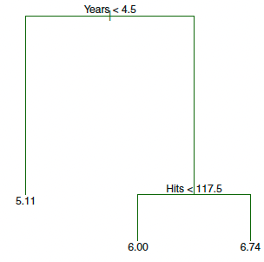
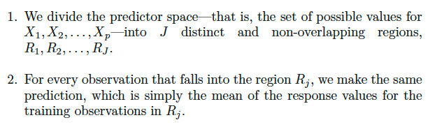
Decision Tree
Decision tree involves stratifying or segmenting the predictor space into a number of simple regions
Can be used for regression and classification
For making prediction, use the mean or mode of the training observations in the region to which it belongs
Splitting rules used to segment the predictor space can be summarized in a tree
Simple and explainable but suffers from overfitting
Pruning – Grow a very large tree and then prune it back in order to obtain a subtree (lowest test error)
Decision tree serves as the building block for other widely used ML algorithms like Random Forest, Boosting etc.
R1, R2 and R3 are terminal nodes or leaves
Goal is to find boxes R1,..Rj that minimize the RSS

Slide 14
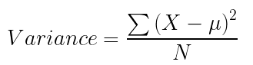
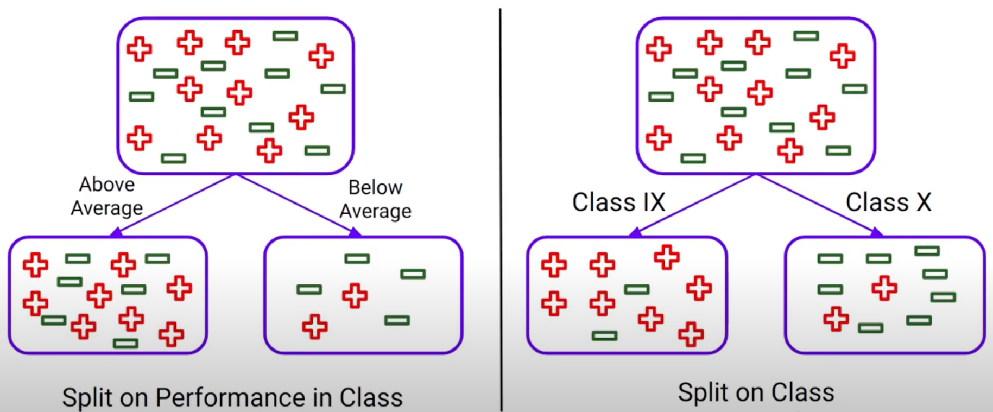
Decision Tree Split Methods
While building Decision Tree with multiple features, we need to choose the best features to split
Decision Tree follows a greedy strategy
Way of splitting a node can be divided into two categories based on the type of target variables
Continuous Target Variable (Regression): Reduction in Variance.
Categorical Target Variable (Classification): Gini Impurity, Information Gain and Chi-Square
Reduction in Variance
For each split, individually calculate the variance of each child node
Calculate the variance of each split as the weighted average variance of child nodes
Select the split with the lowest variance
Perform steps 1-3 until completely homogeneous nodes are achieved

Slide 15
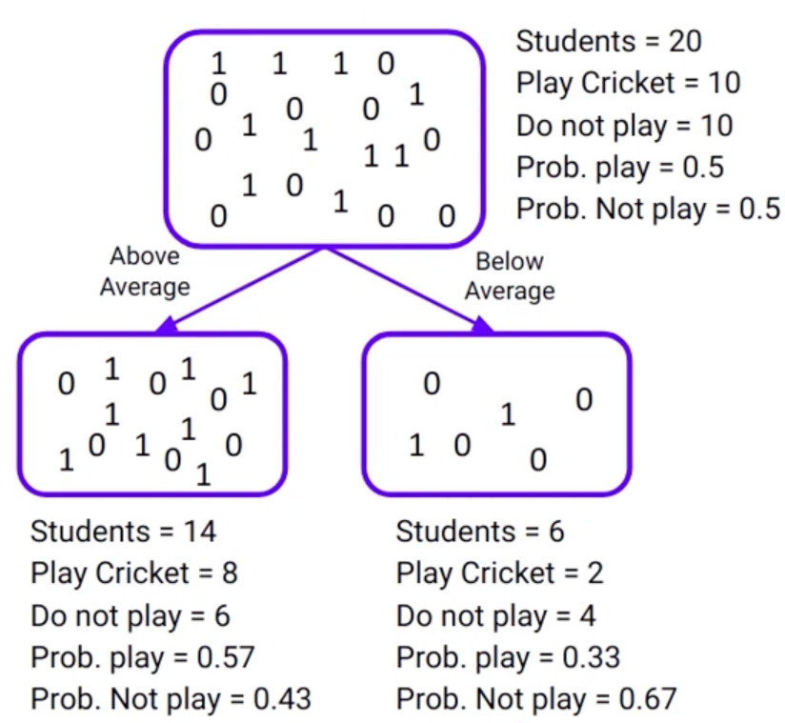
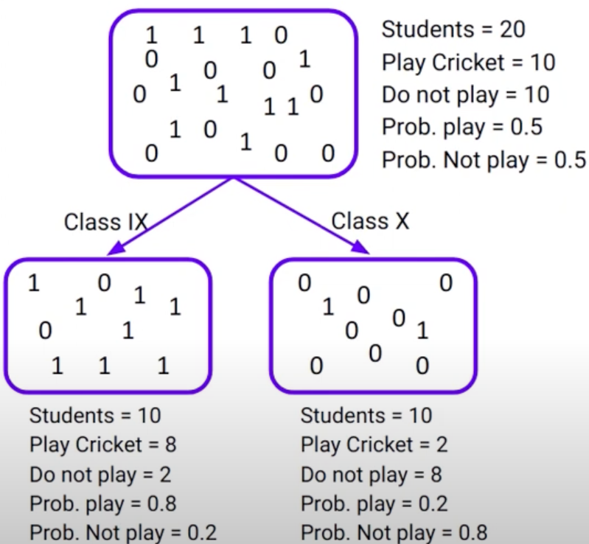
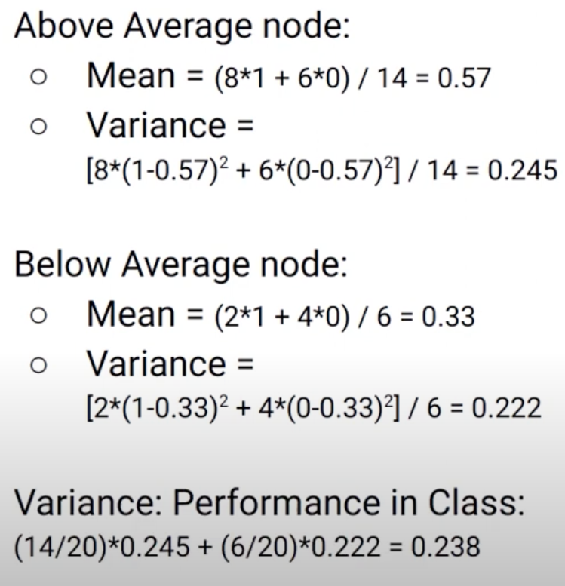
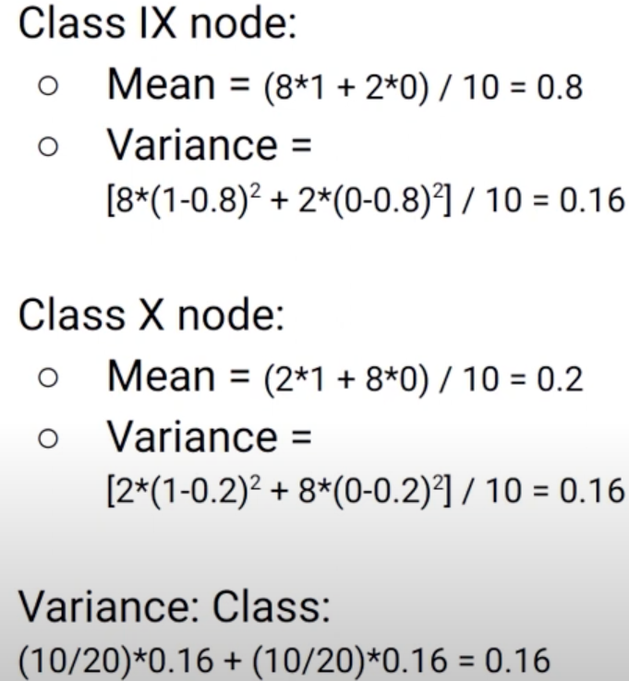
Reduction in Variance
Variance is less for class variable

Slide 16
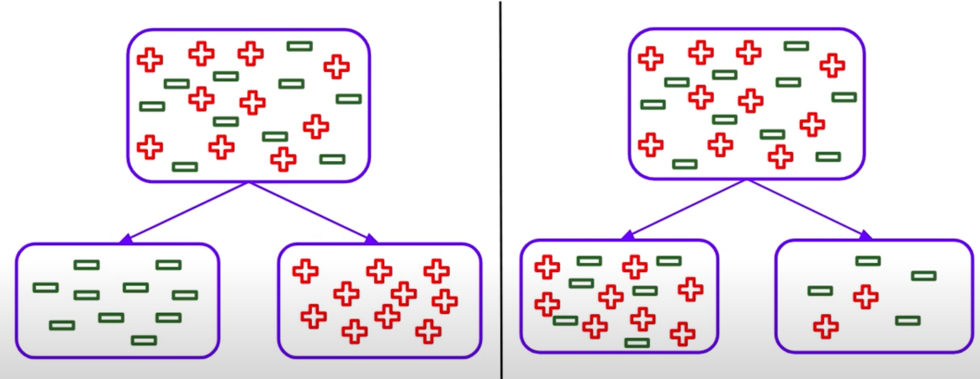
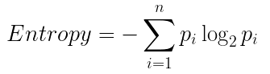
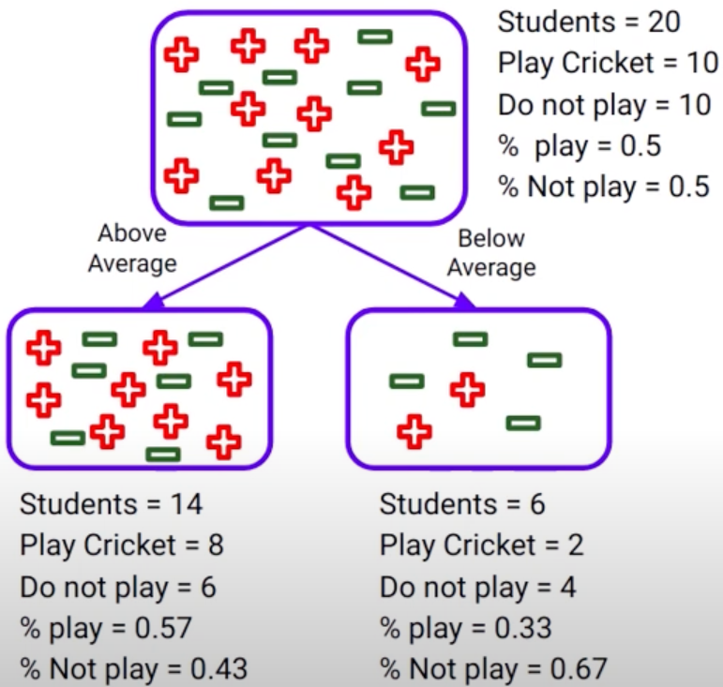
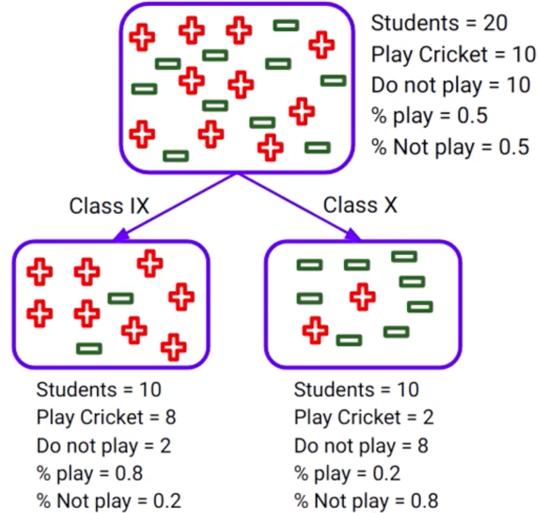
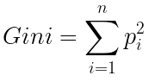
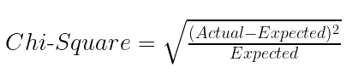
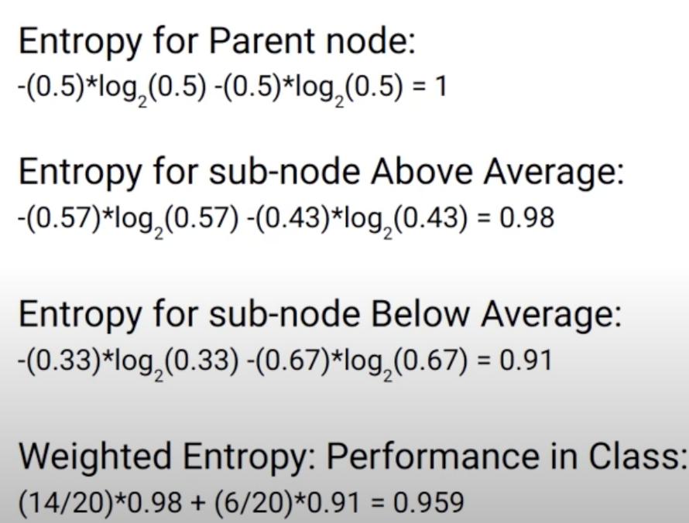
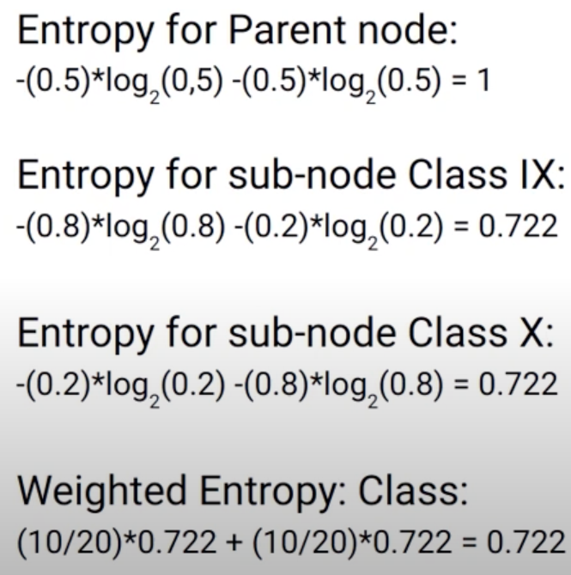
Information Gain
Information Gain method is used for splitting the nodes when the target variable is categorical
Information Gain = 1 – Entropy. (Entropy is used to calculate the purity of node)
Lower the value of entropy, higher the purity of node.
Information Gain is more for Class feature
Other Methods:
Gini Impurity = 1- Gini
Chi-Square

Slide 17
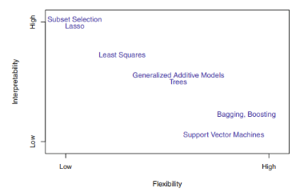
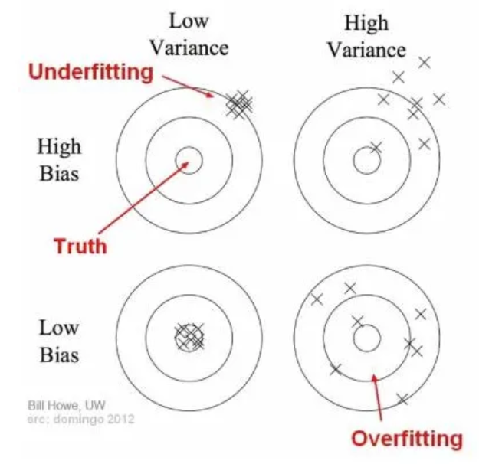
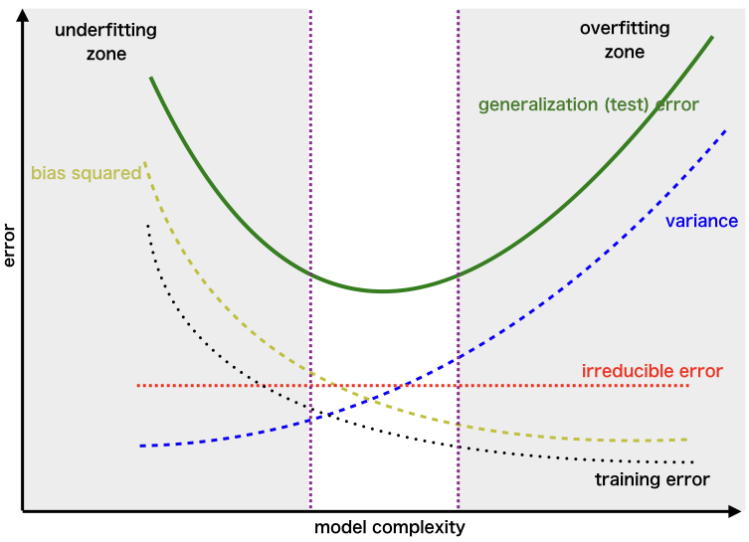
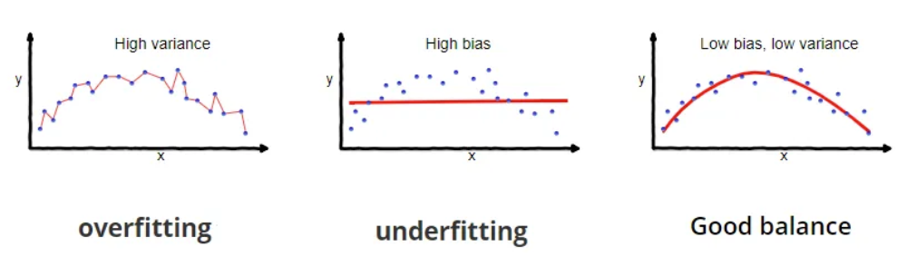
Bias-Variance Tradeoff

Slide 18
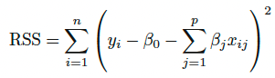
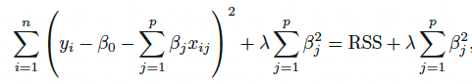
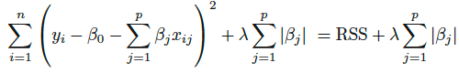
Regularization
Technique to prevent overfitting
Adding penalty term to loss function
This penalty term helps to shrink the coefficients towards zero
Shrinkage methods: Ridge, Lasso & Elastic Net
Ridge Regression (L2 Regularization)
Lasso Regression (L1 Regularization)
Lambda is the regularization parameter
Shrinkage penalty is small when weights are close to zero
Not applied for intercept
Can perform better than least squares when no of features are large
Have substantial computational advantage over best subset selection
Though it shrink weights, they don’t become 0, hence final model still includes all features (disadvantage)
Lasso shrinks the coefficient estimates towards 0
Performs variable selection
Easier to interpret (sparse model)

Slide 19
Data Processing, Feature Engineering and Selection
Standardization & Normalization
Transformation
Zero Variance
Null Values
Missing Value Imputation
Feature Derivation
Feature Selection
Outlier Removal
Dimensionality Reduction

Slide 20
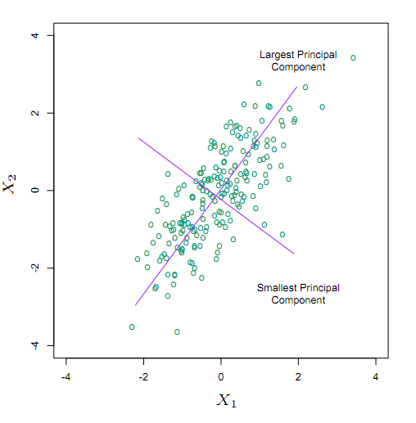
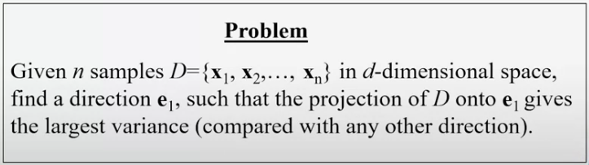
Dimensionality Reduction - PCA
Dimensionality reduction refers to reducing the number of input variables in a dataset
Fewer input variables can result in a simpler predictive model that may have better performance when making predictions on new data
PCA - Statistical technique used to reduce the dimensionality of a large dataset
Identify patterns in the data and then create new variables (principal components) that capture as much of the variation in the data as possible
Principal components are linear combinations of the original variables in the dataset
Principal components are orthogonal to each other
PCA transforms the data into fewer dimensions that act as summaries if features.
“Most descriptive” = Largest “variance”
Find the direction of the largest variance

Slide 21
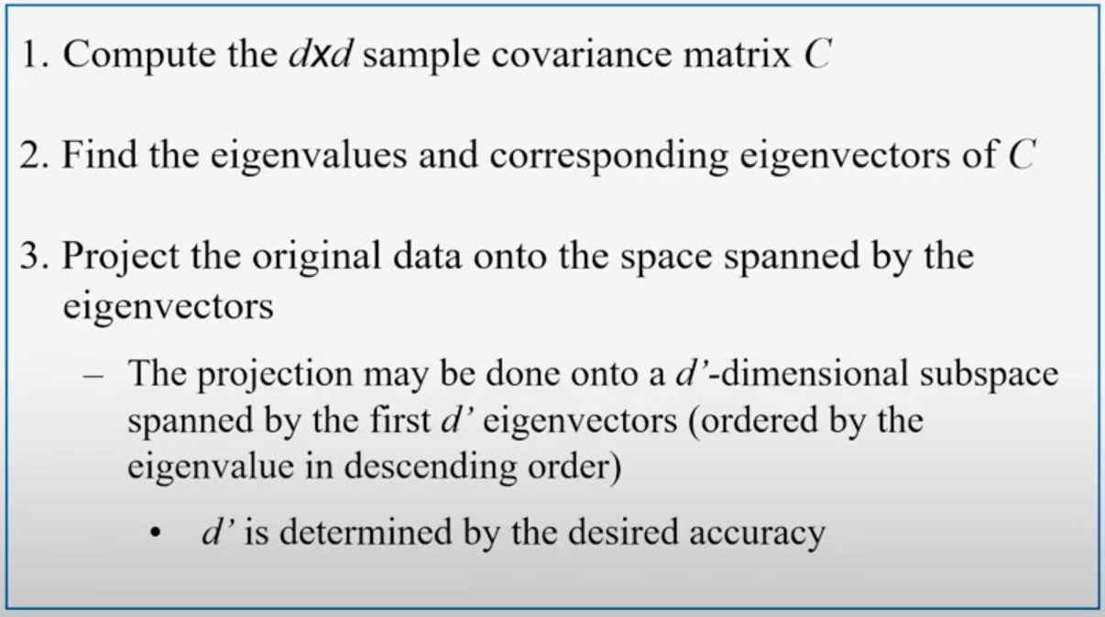
PCA
To reduce dimensions, we will need to keep only d` << d projections
Algorithm
Steps to compute PCA
Standardize each column
Compute Covariance Matrix
Compute Eigen Values & Eigen Vectors
Derive PCA features by taking dot product of eigen vector and standardized columns

Slide 22
Other Algorithms for Regression
Tree Models for Regressors
Random Forest
Boosting
Naïve Bayes for Regression
Support Vector Machine
Neural Networks
PS: Some of these algorithms will be covered in detail in following sessions

Slide 23
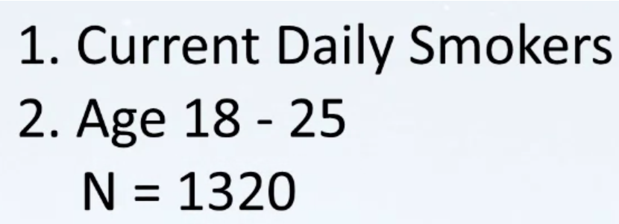
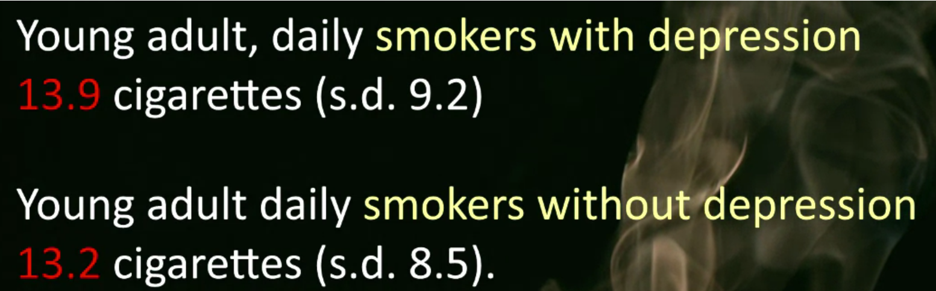
Hypothesis Testing
Assessing evidence provided by the data, in favor of or against each hypothesis about the population.
Steps in Hypothesis testing
Specifying the Null Hypothesis (Ho) and the alternative (Ha) hypothesis
Choose a sample
Assess the evidence
Draw conclusions
Example:
Relationship with smoking (no of cigarettes) and Depression
Null Hypothesis (Ho) - There is no difference in the no: of cigarettes consumed by people with and without depression --> Smoking and depression are unrelated
Alternative Hypothesis (Ha) - These is a difference --> Smoking and depression are related
Though 13.9 > 13.2, can we make any conclusion about the Hypothesis?
How likely is to get data like this when the null hypothesis is true? Null hypothesis is generally true until evidence indicates otherwise
p-value:
The p-value estimates how likely it is that you would see the difference described by the test statistic if the null hypothesis of no relationship were true.

Slide 24


Bivariate Statistical Tools

